Slide 1

Database Technologies - MySQL
A day without new knowledge is a lost day.
Before we start DBT module.
Which module(s) you have completed?
iet
If A and a, B and b, C and c etc. are treated in the same way then it is case-insensitive. MySQL is case-insensitive
In this module we are going to learn SQL, PL/SQL and NoSQL(MongoDB)

Slide 2
Class Room
Session 1

Slide 3
Introduction
If anyone who wants to develop a good application
then he should have the knowledge three major components.
They are . . . . .
Presentation Tier [ UI ]
Application Tier [ Server Application and Client Application ]
Data Tier [ Data Access Object (DAO) / Data Access Layer (DAL) ] { Flat Files | RDBMS | NoSQL }
So as a programmer:
a person should understand and be able to interact with a database is must, so than the data which is collected from the UI is processed and stored permanently. (eg. Any management systems, set top box, washing machine, mobile application etc.).

Slide 4
Introduction
A layer refers to pieces of software that are logically separated, but typically live within the same process and machine.
A tier, instead, refers to pieces of software that live in distinct processes or AppDomains or machines.
A tier refers to physical separation; a layer is about logical separation.

Slide 5
Introduction
Why do we need databases (Use Case)?
We need databases because they organize data in a manner which allows us to store, query, sort, and manipulate data in various ways. Databases allow us to do all this things.
Many companies collects data from different resource (like Weather data, Geographical data, Finance data, Scientific data, Transport data, Cultural data, etc.)

Slide 6
What is Relation and Relationship?

Slide 7
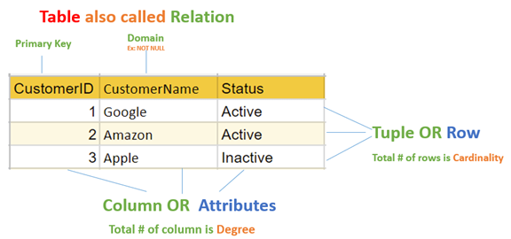
relation and relationship?
Relation (in Relational Algebra "R" stands for relation): In Database, a relation represents a table or an entity than contain attributes.
Relationship: In database, relationship is that how the two entities are connected to each other, i.e. what kind of relationship type they hold between them.
Primary/Foreign key is used to specify this relationship.
Remember:
Foreign Key is also know as
Reference
Referential key.
Note:
Table - The physical instantiation of a relation in the database schema.
Relation - A logical construct that organizes data into rows and columns.

Slide 8
File Systems is the traditional way to keep your data organized.
File System
vs
DBMS

Slide 9
file-oriented system
struct Employee {
int emp_no;
char emp_name[50];
int salary;
} emp[1000];
struct Employee {
int emp_no;
char emp_name[50];
int salary;
};
struct Employee emp[1000];
File Anomalies
c:\employee.txt
c:\employee.txt
c:\employee.txt
c:\employee.txt
c:\employee.txt
1 suraj 4000
2 ramesh 6000
3 rajan 4500
. |
. |
. |
500 sam 3500
. |
. |
. |
1000 amit 2300
1 suraj 4000
2 ramesh 6000
3 rajan 4500
. |
. |
. |
500 sam 3500
. |
. |
1000 amit 2300
. |
. |
. |
2000 jerry 4500
. |
. |
1 suraj 4000
2 ramesh 6000
3 rajan 4500
. |
. |
. |
500 sam 3500
. |
. |
1000 amit 2300
. |
1000 amit 2300
. |
2000 jerry 4500
. |
. |
1 suraj 4000
2 ramesh 6000
3 rajan 4500
. |
. |
. |
sam 500 3500
. |
. |
1000 amit 2300
. |
1000 amit 2300
. |
jerry 2000 4500
. |
. |
1 suraj 4000
2 ramesh 6000
3 rajan 4500
. |
. |
. |
500 sam 3500
. |
. |
. |
. |
. |
1250 neel 4500

Slide 10
Create/Open an existing file
Reading from file
Writing to a file
Closing a file
file-oriented system
File Anomalies
c:\employee.txt
file attributes
file permissions
search empl ID=1
search emp_name
1 suraj 4000
2 ramesh 6000
3 rajan 4500
. |
. |
. |
500 sam 3500
. |
. |
. |
1000 amit 2300
File Name
Type
Location
File permissions
Share permissions
1 suraj 4000
2 ramesh 6000
3 rajan 4500
. |
. |
. |
500 sam 3500
. |
. |
. |
1000 amit 2300
1 suraj 4000
2 ramesh 6000
3 rajan 4500
. |
. |
. |
500 sam 3500
. |
. |
. |
1000 amit 2300

Slide 11
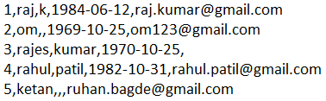
file-oriented system
A flat file database is a database that stores data in a plain text file (e.g. *.txt, *.csv, *.tsv etc. format). Each line of the text file holds one record, with fields separated by delimiters, such as commas or tabs.
1 rajan MG Road Pune MH 34500
2 rahul patil SSG Lane Pune MH 54000
3 suraj raj k Deccan Gymkhana Pune MH 22000
4, S M Kumar, Mg Road Pune MH, 32000
5, S M Kumar, Mg Road, Pune, MH, 32000
The Zen of Python,
Beautiful is better than ugly.
Explicit is better than implicit.
Simple is better than complex.
Complex is better than complicated.
Flat is better than nested.
Sparse is better than dense.
Readability counts.
Special cases aren't special enough to break the rules.
Although practicality beats purity.
Errors should never pass silently.
Unless explicitly silenced.
In the face of ambiguity, refuse the temptation to guess.
There should be one-- and preferably only one --obvious way to do it.
Although that way may not be obvious at first unless you're Dutch.
Now is better than never.
Although never is often better than *right* now.
If the implementation is hard to explain, it's a bad idea.
If the implementation is easy to explain, it may be a good idea.
Namespaces are one honking great idea -- let's do more of those!

Slide 12
advantages of file-oriented system
The biggest advantage of file-based storage is that anyone can understand the system.
Advantage of File-oriented system
Backup: It is possible to take faster and automatic back-up of database stored in files of computer-based systems.
Data retrieval: It is possible to retrieve data stored in files in easy and efficient way.
Editing: It is easy to edit any information stored in computers in form of files.
Remote access: It is possible to access data remote location.
Sharing: The files stored in systems can be shared among multiple users at a same time.

Slide 13
disadvantage of file-oriented system
The biggest disadvantage of file-based storage is as follows.
Disadvantage of File-oriented system
Data redundancy: It is possible that the same information may be duplicated in different files. This leads to data redundancy results in memory wastage. (Suppose a customer having both kind of accounts- saving and current account. In such a situation a customers detail are stored in both the file, saving.txt- file and current.txt- file , which leads to Data Redundancy.)
Data inconsistency: Because of data redundancy, it is possible that data may not be in consistent state. (Suppose customer changed his/her address. There might be a possibility that address is changed in only one file (saving.txt) and other (current.txt) remain unchanged.)
Limited data sharing: Data are scattered in various files and also different files may have different formats (for example: .txt, .csv, .tsv and .xml) and these files may be stored in different folders so, due to this it is difficult to share data among different applications.
Data Isolation: Because data are scattered in various files, and files may be in different formats (for example: .txt, .csv, .tsv and .xml), writing new application programs to retrieve the appropriate data is difficult.
Data security: Data should be secured from unauthorized access, for example a account holder in a bank should not be able to see the account details of another account holder, such kind of security constraints are difficult to apply in file processing systems.

Slide 14

Relation Schema: A relation schema represents name of the relation with its attributes.
e.g. student (roll_no, name, address, phone and age) is relation schema for STUDENT
DBMS
The database management system (DBMS) is the software that interacts with end users, applications, and the database itself to store and analyze the data.
database: Is the collection of related data which is organized, database can store and retrieve large amount of data easily, which is stored in one or more data files by one or more users, it is called as structured data.
management system: it is a software, designed to define, manipulate, retrieve and manage data in a database.
A database is an organized collection of structured data.

Slide 15



relational database management system?
A RDBMS is a database management system (DBMS) that is based on the relational model introduced by Edgar Frank Codd at IBM in 1970.
RDBMS supports
client/server Technology
Highly Secured
Relationship (PK/FK)
A server is a computer program or device that provides a service to another computer program and its user, also known as the client.
In the client/server programming model, a server program awaits and fulfills requests from client programs, which might be running in the same, or other computers.

Slide 16
relational model concepts
and
properties of relational table

Slide 17
relational model concepts
Relational model organizes data into one or more tables (or "relations") of columns and rows. Rows are also called records or tuples. Columns are also called attributes.
Tables − In relational model, relations are saved in the form of Tables. A table has rows and columns.
Attribute − Attributes are the properties that define a relation. e.g. (roll_no, name, address, phone and age)
Tuple − A single row of a table, which contains a single record for that relation is called a tuple.
Relation schema − A relation schema describes the relation name (table name) with its attribute (columns) names.
Attribute domain − Every attribute has some pre-defined datatypes, known as attribute domain.
Relation key − Each row has one or more attributes, known as relation key, which can identify the row in the relation (table) uniquely.
e.g. student(roll_no, name, address, phone and age) is relation schema for student relation.

Slide 18
properties of relational table
ID | job | firstName | DoB | salary
1 | manager | Saleel Bagde | yyyy-mm-dd | ●●●●●●
3 | salesman | Sharmin | yyyy-mm-dd | ●●●●●●
4 | accountant | Vrushali | yyyy-mm-dd | ●●●●●●
2 | salesman | Ruhan | yyyy-mm-dd | ●●●●●●
5 | 9500 | manager | yyyy-mm-dd | ●●●●●●
5 | Salesman | Rahul Patil | yyyy-mm-dd | ●●●●●●
Domain refers to all the valid values which a column may contain.
Relational tables have six properties:
Values are atomic.
Column values are of the same kind. (Attribute Domain: Every attribute has some pre-defined datatypes, known as attribute domain.)
Each row is unique.
The sequence of columns is insignificant – (unimportant).
The sequence of rows is insignificant – (unimportant).
Each attribute/column must have a unique name.

Slide 19

What is data?

Slide 20

what is data?
Data is any facts that can be stored and that can be processed by a computer.
Data can be in the form of Text or Multimedia
e.g.
number, characters, or symbol
images, audio, video, or signal

Slide 21
What is Entity Relationship Diagram?

Slide 22
Entity Relationship Diagram (ER Diagram)
Use E-R model to get a high-level graphical view to describe the "ENTITIES" and their "RELATIONSHIP"
The basic constructs/components of ER Model are
Entity, Attributes and Relationships.

Slide 23
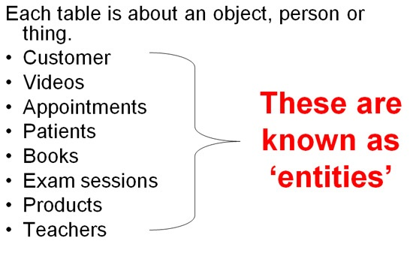
An entity can be a real-world object.
What is Entity?

Slide 24
entity
In relation to a database , an entity is a
Person(student, teacher, employee, department, …)
Place(classroom, building, …) --a particular position or area
Thing(computer, lab equipment, …) --an object that is not named
Concept(course, batch, student’s attendance, …) -- an idea,
about which data can be stored. All these entities have some attributes or properties that give them their identity.
Every entity has its own characteristics.

Slide 25

When you are designing attributes for your entities, you will sometimes find that an attribute does not have a value. For example, you might want an attribute for a person's middle name, but you can't require a value because some people have no middle name. For these, you can define the attribute so that it can contain null values.
What is an Attribute?
Attributes are the properties that define a relation.
e.g. student(ID, firstName, middleName, lastName, city)
Entity
In some cases, you might not want a specific attribute to contain a null value, but you don't want to require that the user or program always provide a value. In this case, a default value might be appropriate. A default value is a value that applies to an attribute if no other valid value is available.
Attribute

Slide 26
attributes
A table has rows and columns
In RDBMS, a table organizes data in rows and columns. The COLUMNS are known as ATTRIBUTES / FIELDS whereas the ROWS are known as RECORDS / TUPLE.
In Relation: EMP
Attributes
ID | EmployeeName | Job | Hiredate | Salary
1 | KING | PRESIDENT | 2017-02-15 | 5000
… | … | … | … | …
… | … | … | … | …
… | … | … | … | …
Rows

Slide 27
attributes
In Entity Relationship(ER) Model attributes can be classified into the following types.
Simple/Atomic and Composite Attribute
Single Valued and Multi Valued attribute
Stored and Derived Attributes
Complex Attribute

Slide 28
attributes
Simple / Atomic Attribute --VS-- Composite Attribute
(Can’t be divided further) (Can be divided further)
Single Value Attribute --VS-- Multi Valued Attribute
(Only One value) (Multiple values)
Stored Attribute --VS-- Derived Attribute
(Only One value) (Virtual)
Complex Attribute
(Composite & Multivalued)
Atomic Attribute: An attribute that cannot be divided into smaller independent attribute is known as atomic attribute.
e.g. ID’s, age, gender, zip, marital status cannot further divide.
Single Value Attribute: An attribute that has only single value is known as single valued attribute.
e.g. manufactured part can have only one serial number, voter card, blood group, price, quantity, branch can have only one value.
Stored Attribute: The stored attribute are such attributes which are already stored in the database and from which the value of another attribute is derived.
e.g. (HRA, DA…) can be derive from salary, age can be derived from DoB, total marks or average marks of a student can be derived from marks.

Slide 29
Composite VS Multi Valued Attribute

Slide 30

composite / multi valued attributes
Composite Attribute
Person Entity
Name attribute: ( firstName, middleName, and lastName )
PhoneNumber attribute: ( countryCode, cityCode, and phoneNumber )
Multi Valued Attribute
Person Entity
Hobbies attribute: [ reading, hiking, hockey, skiing, photography, . . . ]
SpokenLanguages attribute: [ Hindi, Marathi, Gujarati, English, . . . ]
Degrees attribute: [ 10th , 12th, BE, ME, PhD, . . . ]
emailID attribute: [ saleel@gmail.com, salil@yahoomail.com, . . . ]

Slide 31
What is an Prime, Non-Prime Attribute?

Slide 32
attributes
Prime attribute (Entity integrity)
An attribute, which is a part of the prime-key (candidate key), is known as a prime attribute.
Non-prime attribute
An attribute, which is not a part of the prime-key (candidate key), is said to be a non-prime attribute.

Slide 33
Entity Relationship Diagram Symbols

Slide 34
erdplus.com
www.draw.io
entity relationship diagram symbols
Attribute
Composite Attribute
Key Attribute
Strong Entity
Weak Entity
Derived Attribute
Weak Relationship
Relationship
Multivalued Attribute

Slide 35
strong and weak entity
An entity may participate in a relation either totally or partially.
Strong Entity: A strong entity is not dependent on any other entity in the schema. A strong entity will always have a primary key. Strong entities are represented by a single rectangle.
Weak Entity: A weak entity is dependent on a strong entity to ensure its existence. Unlike a strong entity, a weak entity does not have any primary key. A weak entity is represented by a double rectangle. The relation between one strong and one weak entity is represented by a double diamond. This relationship is also known as identifying relationship.

Slide 36
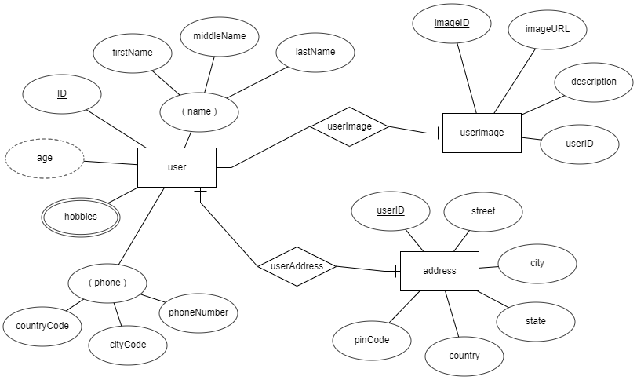
entity relationship diagram
DoB

Slide 37
What is a degree, cardinality, domain and union in database?

Slide 38
What is a degree, cardinality, domain and union in database?
Degree d(R) / Arity: Total number of attributes/columns present in a relation/table is called degree of the relation and is denoted by d(R).
Cardinality |R|: Total number of tuples/rows present in a relation/table, is called cardinality of a relation and is denoted by |R|.
Domain: Total range of accepted values for an attribute of the relation is called the domain of the attribute. (Data Type)
Union Compatibility: Two relations R and S are set to be Union Compatible to each other if and only if:
They have the same degree d(R).
Domains of the respective attributes should also be same.

Slide 39
What is domain constraint and types of data integrity constraints?

Slide 40
Data integrity refers to the correctness and completeness of data.
A domain constraint and types of data integrity constraints
Domain Constraint = data type + Constraints (not null/unique/primary key/foreign key/check/default)
e.g. custID INT, constraint pk_custid PRIMARY KEY(custID)
Three types of integrity constraints: entity integrity, referential integrity and domain integrity:
Entity integrity: Entity Integrity Constraint is used to ensure the uniqueness of each record the table. There are primarily two types of integrity constraints that help us in ensuring the uniqueness of each row, namely, UNIQUE constraint and PRIMARY KEY constraint.
Referential integrity: Referential Integrity Constraint ensures that there always exists a valid relationship between two tables. This makes sure that if a foreign key exists in a table relationship then it should always reference a corresponding value in the second table or it should be null.
Domain integrity: A domain is a set of values of the same type. For example, we can specify if a particular column can hold null values or not, if the values have to be unique or not, the data type or size of values that can be entered in the column, the default values for the column, etc..

Slide 41
types of Keys?

Slide 42
Keys are used to establish relationships between tables and also to uniquely identify any record in the table.
types of Keys?
r = Employee(EmployeeID, FullName, job, salary, PAN, DateOfBirth, emailID, deptno)
Candidate Key: are individual columns in a table that qualifies for uniqueness of all the rows. Here in Employee table EmployeeID, PAN or emailID are Candidate keys.
Primary Key: is the columns you choose to maintain uniqueness in a table. Here in Employee table you can choose either EmployeeID, PAN or emailID columns, EmployeeID is preferable choice.
Alternate Key: Candidate column other the primary key column, like if EmployeeID is primary key then , PAN or emailID columns would be the Alternate key.
Super Key: If you add any other column to a primary key then it become a super key, like EmployeeID + FullName is a Super Key.
Composite Key: If a table do not have any single column that qualifies for a Candidate key, then you have to select 2 or more columns to make a row unique. Like if there is no EmployeeID, PAN or emailID columns, then you can make FullName + DateOfBirth as Composite key. But still there can be a narrow chance of duplicate row.

Slide 43
Degrees of relationship
The degree of relationship can be defined as the number of occurrences in one entity that is associated with the number of occurrences in another entity.

Slide 44

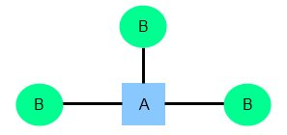
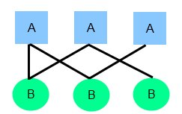
relationships
There are three degrees of relationship
one-to-one (1:1)
one-to-many (1:M)
many-to-many (M:N)

Slide 45
one-to-one relationship

Slide 46
one-to-one relationship
A one-to-one relationship between two tables means that a row in one table can only relate to zero/one row in the table on the other side of their relationship. This is the least common database relationship.
A one-to-one relationship is a type of cardinality that refers to the relationship between two entities R and S in which one element of entity R may only be linked to zero/one element of entity S, and vice versa.
Country
Capital
Country
Capital
Country
one-to-one relationship
Capital
Country
Capital
=
Country
Capital
Country
Capital

Slide 47
one-to-one relationship
A one-to-one relationship between two tables means that a row in one table can only relate to zero/one row in the table on the other side of their relationship. This is the least common database relationship.
A one-to-one relationship is a type of cardinality that refers to the relationship between two entities R and S in which one element of entity R may only be linked to zero/one element of entity S, and vice versa.
Person-1
Passport-1
Person-1
Passport-1
Person-2
Passport-1
Person-2
Passport-1
one-to-one relationship
=
Person-3
Passport-1
Person-4
Passport-1
Person-4

Slide 48
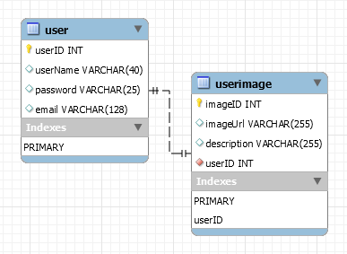
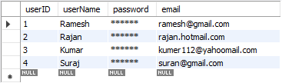
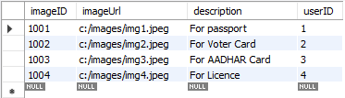
how to create one-to-one relationship
CREATE TABLE user (
userID INT PRIMARY KEY,
userName VARCHAR(40),
password VARCHAR(25),
email VARCHAR(128)
) ;
CREATE TABLE userImage (
imageID INT PRIMARY KEY,
imageUrl VARCHAR(255),
description VARCHAR(255),
userID INT NOT NULL UNIQUE,
FOREIGN KEY(UserID) REFERENCES user(userID)
) ;

Slide 49
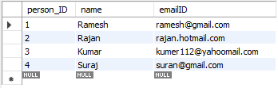

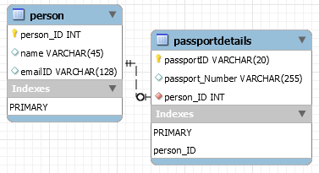
how to create one-to-one relationship
CREATE TABLE person (
person_ID INT PRIMARY KEY ,
name VARCHAR(45),
emailID VARCHAR(128)
);
CREATE TABLE passportDetails (
passportID VARCHAR(20) PRIMARY KEY,
passport_Number VARCHAR(255),
person_ID INT UNIQUE,
FOREIGN KEY(person_ID) REFERENCES person(person_ID)
);

Slide 50
one-to-many relationship

Slide 51
one-to-many relationship
A one-to-many relationship between two tables means that a row in one table can have zero or more row in the table on the other side of their relationship.
a one-to-many relationship is a type of cardinality that refers to the relationship between two entities R and S in which an element of R may be linked to many elements of S, but a member of S is linked to only one element of R.
Customer-1
Order-1
Customer-1
Order-1
Customer-2
Order-1
Customer-2
Order-1
one-to-many relationship
Customer-3
Order-2
=
Customer-2
Order-2
Customer-4
Order-1
Customer-3
Order-1
Customer-5
Order-2
Customer-3
Order-2
Order-3
Customer-3
Order-3
Order-1
Customer-4
Order-1

Slide 52
one-to-many relationship
A one-to-many relationship between two tables means that a row in one table can have one or more row in the table on the other side of their relationship.
a one-to-many relationship is a type of cardinality that refers to the relationship between two entities R and S in which an element of R may be linked to many elements of S, but a member of S is linked to only one element of R.
Invoice-1
Invoice_Item-1
Invoice-1
Invoice_Item-1
Invoice-2
Invoice_Item-1
Invoice-2
Invoice_Item-1
one-to-many relationship
Invoice-3
Invoice_Item-2
=
Invoice-2
Invoice_Item-2
Invoice-4
Invoice_Item-1
Invoice-3
Invoice_Item-1
Invoice_Item-2
Invoice-3
Invoice_Item-2
Invoice_Item-2
Invoice-3
Invoice_Item-3
Invoice_Item-1
Invoice-4
Invoice_Item-1

Slide 53
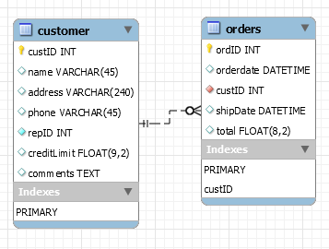
how to create one-to-many relationship
CREATE TABLE customer (
custID INT PRIMARY KEY,
name VARCHAR(45),
address VARCHAR(240),
phone VARCHAR(45),
repID INT NOT NULL,
creditLimit FLOAT(9,2),
comments TEXT,
constraint custid_zero CHECK(custID > 0)
);
CREATE TABLE orders (
ordID INT PRIMARY KEY,
orderdate DATETIME,
custID INT NOT NULL,
shipDate DATETIME,
total FLOAT(8,2),
FOREIGN KEY(custID) REFERENCES customer(custID),
constraint total_greater_zero CHECK(total >= 0)
);

Slide 54
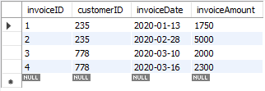
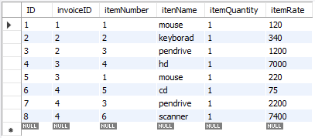
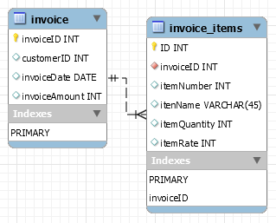
how to create one-to-many relationship
CREATE TABLE invoice (
invoiceID INT PRIMARY KEY,
customerID INT,
invoiceDate DATE,
invoiceAmount INT
);
CREATE TABLE invoice_items (
ID INT PRIMARY KEY,
invoiceID INT NOT NULL,
itemNumber INT,
itenName VARCHAR(45),
itemQuantity INT,
itemRate INT,
FOREIGN KEY(invoiceID) REFERENCES invoice(invoiceID)
);

Slide 55
many-to-one relationship

Slide 56
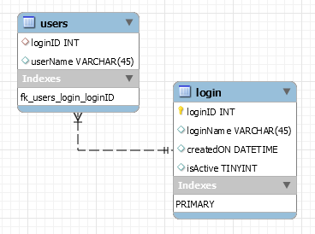
many-to-one relationship
CREATE TABLE users (
loginID INT,
userName VARCHAR(45),
constraint fk_users_login_loginID FOREIGN KEY(loginID) REFERENCES login(loginID)
);
CREATE TABLE login (
loginID INT,
loginName VARCHAR(45),
createdON DATETIME,
isActive TINYINT,
PRIMARY KEY(loginID)
);

Slide 57
many-to-many relationship

Slide 58
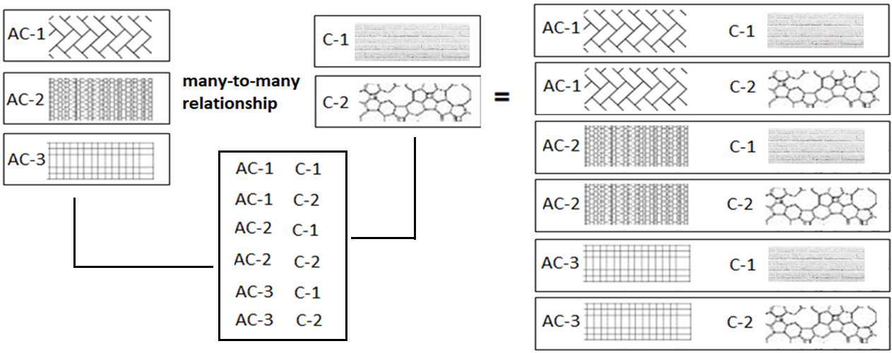
many-to-many relationship
A many-to-many relationship is a type of cardinality that refers to the relationship between two entities R and S in which R may contain a parent instance for which there are many children in S and vice versa.
=
=

Slide 59
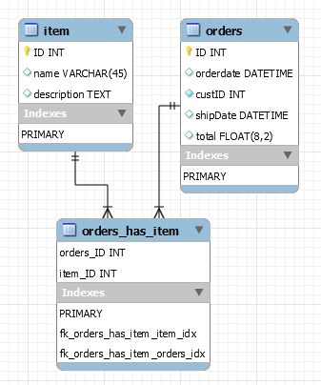
how to create many-to-many relationship
CREATE TABLE item (
item_ID INT PRIMARY KEY,
name VARCHAR(45),
description TEXT
);
CREATE TABLE orders (
orders_ID INT PRIMARY KEY,
orderdate DATETIME,
custID INT NOT NULL,
shipDate DATETIME,
total FLOAT(8,2),
constraint total_greater_zero CHECK(total >= 0)
);
CREATE TABLE orders_has_item (
orders_ID INT NOT NULL,
item_ID INT NOT NULL,
PRIMARY KEY(orders_ID, item_ID),
constraint fk_orders_has_item_orders FOREIGN KEY(orders_ID)
REFERENCES orders(ID),
constraint fk_orders_has_item_item1 FOREIGN KEY(item_ID)
REFERENCES item(ID)
);

Slide 60
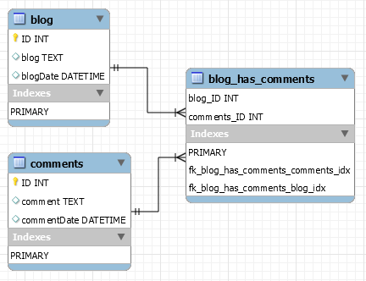
how to create many-to-many relationship
CREATE TABLE blog (
ID INT PRIMARY KEY,
blog TEXT,
blogDate DATETIME
);
CREATE TABLE comments (
ID INT PRIMARY KEY,
comment TEXT,
commentDate DATETIME
);
CREATE TABLE blog_has_comments (
blog_ID INT,
comments_ID INT,
PRIMARY KEY(blog_ID, comments_ID),
constraint fk_blog_has_comments_blog FOREIGN KEY(blog_ID) REFERENCES blog(ID),
constraint fk_blog_has_comments_comments FOREIGN KEY(comments_ID) REFERENCES comments(ID)
);

Slide 61

MySQL
MySQL is the most popular Open Source
Relational Database Management System.
MySQL was created by a Swedish company - MySQL AB that was founded in 1995. It was acquired by Sun Microsystems in 2008; Sun was in turn acquired by Oracle Corporation in 2010.
When you use MySQL, you’re actually using at least two programmes. One program is the MySQL server (mysqld.exe) and other program is MySQL client program (mysql.exe) that connects to the database server.

Slide 62
What is SQL?

Slide 63

what is sql?
Remember:
EXPLICIT or IMPLICIT commit will commit the data.
SQL (Structured Query Language) is a database language designed and developed for managing data in relational database management systems (RDBMS). SQL is common language for all Relational Databases.

Slide 64
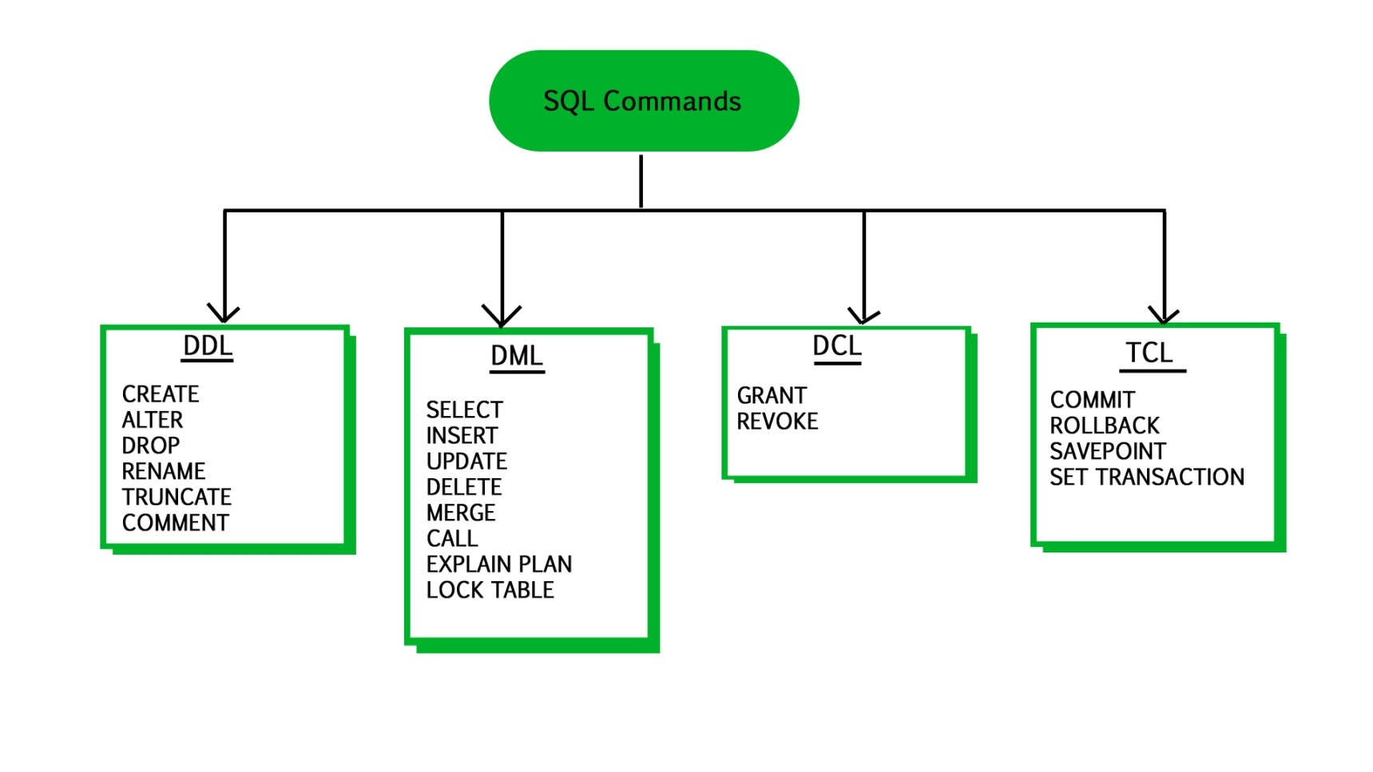
what is sql?
Remember:
An EXPLICIT commit happens when we execute an SQL "COMMIT" command.
An IMPLICIT commits occur without running a "COMMIT" command.
Remember:
A NULL value is not treated as a blank or 0. Null or NULL is a special marker used in Structured Query Language to indicate that a data value does not exist in the database.
Degree d(R): Total no. of attributes/columns present in a relation/table is called degree of the relation and is denoted by d(R).
Cardinality |R|: Total no. of tuples present in a relation or Rows present in a table, is called cardinality of a relation and is denoted by |R|.

Slide 65
comments in mysql
From a # character to the end of the line.
From a -- sequence to the end of the line.
From a /* sequence to the following */ sequence.
Reconnect to the server | \r
Execute a system shell command | \!
Exit mysql | \q

Slide 66
Login to MySQL

Slide 67
The char is a fixed-length character data type,
The varchar is a variable-length character data type.
CREATE TABLE temp (c1 CHAR(10), c2 VARCHAR(10));
INSERT INTO temp VALUES('SALEEL', 'SALEEL');
SELECT * FROM temp WHERE c1 LIKE 'SALEEL';
datatypes
ENAME CHAR (10) | S | A | L | E | E | L |  |  |  |  | LENGTH -> 10
ENAME VARCHAR2(10) | S | A | L | E | E | L |  |  |  |  | LENGTH -> 6
When CHAR values are retrieved, the trailing spaces are removed (unless the PAD_CHAR_TO_FULL_LENGTHSQL mode is enabled)
In MySQL
ENAME CHAR (10) | S | A | L | E | E | L |  |  |  |  | LENGTH -> 6
ENAME VARCHAR(10) | S | A | L | E | E | L |  |  |  |  | LENGTH -> 6
Note:
The BINARY and VARBINARY types are similar to CHAR and VARCHAR, except that they store binary strings rather than nonbinary strings. That is, they store byte strings rather than character strings.

Slide 68
datatype - string
Datatypes | Size | Description
CHAR [(length)] | 0-255
VARCHAR (length) | 0 to 65,535 | The maximum row size (65,535 bytes, which is shared among all columns.
TINYTEXT [(length)] | (2⁸ − 1) bytes
TEXT [(length)] | (2¹⁶ -1) bytes | 65,535 bytes ~ 64kb
MEDIUMTEXT [(length)] | (2²⁴ -1) bytes | 16,777,215 bytes ~16MB
LONGTEXT [(length)] | (2³² -1) bytes | 4,294,967,295 bytes ~4GB
ENUM('value1', 'value2',...) | 65,535 members
SET('value1', 'value2',...) | 64 members
BINARY[(length)] | 255
VARBINARY(length)
By default, trailing spaces are trimmed from CHAR column values on retrieval. If PAD_CHAR_TO_FULL_LENGTH is enabled, trimming does not occur and retrieved CHAR values are padded to their full length.
SET sql_mode = '';
SET sql_mode = 'PAD_CHAR_TO_FULL_LENGTH';

Slide 69
example of char and varchar
Datatypes | Size | Description
CHAR [(length)] | 0-255
VARCHAR (length) | 0 to 65,535 | The maximum row size (65,535 bytes, which is shared among all columns.
In CHAR, if a table contains value 'a', an attempt to store 'a ' causes a duplicate-key error.
Try Out
CREATE TABLE x (x1 CHAR(4), x2 VARCHAR(4));
INSERT INTO x VALUE('', '');
INSERT INTO x VALUE('ab', 'ab');
INSERT INTO x VALUE('abcd', 'abcd');
SELECT x1, LENGTH(x1), x2, LENGTH(x2) FROM x;
SET sql_mode = 'PAD_CHAR_TO_FULL_LENGTH';
SELECT x1, LENGTH(x1), x2, LENGTH(x2) FROM x;
SET sql_mode = '';
SELECT x1, LENGTH(x1), x2, LENGTH(x2) FROM x;
CREATE TABLE x (x1 CHAR(4) PRIMARY KEY, x2 VARCHAR(4));
INSERT INTO x VALUE('a', 'a');
INSERT INTO x VALUE('a ', 'a ');
CREATE TABLE x (x1 CHAR(4), x2 VARCHAR(4) PRIMARY KEY);
INSERT INTO x VALUE('a', 'a');
INSERT INTO x VALUE('a ', 'a ');

Slide 70
datatype - numeric
Datatypes | Size | Description
TINYINT | 1 byte | -128 to +127 (The unsigned range is 0 to 255).
SMALLINT [(length)] | 2 bytes | -32768 to 32767. (The unsigned range is 0 to 65535).
MEDIUMINT [(length)] | 3 bytes | -8388608 to 8388607. (The unsigned range is 0 to 16777215).
INT, INTEGER [(length)] | 4 bytes | -2147483648 to 2147483647. (The unsigned range is 0 to 4294967295).
BIGINT [(length)] | 8 bytes | -9,223,372,036,854,775,808 to 9,223,372,036,854,775,807
FLOAT [(length[,decimals])] | 4 bytes | FLOAT(255,30)
DOUBLE [PRECISION] [(length[,decimals])], REAL [(length[,decimals])] | 8 bytes | REAL(255,30) / DOUBLE(255,30) REAL will get converted to DOUBLE
DECIMAL [(length[,decimals])], NUMERIC [(length[,decimals])] |  | DECIMAL(65,30) / NUMERIC(65,30) NUMERIC will get converted in DECIMAL
For: float(M,D), double(M,D) or decimal(M,D), M must be >= D
Here, (M,D) means than values can be stored with up to M digits in total, of which D digits may be after the decimal point.
UNSIGNED prohibits negative values.

Slide 71
datatype – date and time
Datatypes | Size | Description
YEAR | 1 byte | YYYY
DATE | 3 bytes | YYYY-MM-DD
TIME | 3 bytes | HH:MM:SS
DATETIME | 8 bytes | YYYY-MM-DD hh:mm:ss

Slide 72
Use a CREATE TABLE statement to specify the layout of your table.
CREATE TABLE `123` (c1 INT, c2 VARCHAR(10));
Remember:
Max 4096 columns per table provided the row size <= 65,535 Bytes
create table
Use a CREATE TABLE statement to specify the layout of your table.
Note:
USER TABLES: This is a collection of tables created and maintained by the user. Contain USER information.
DATA DICTIONARY: This is a collection of tables created and maintained by the MySQL Server. It contains database information. All data dictionary tables are owned by the SYS user.

Slide 73
create table
Use a CREATE TABLE statement to specify the layout of your table.
Remember:
by default, tables are created in the default database, using the InnoDB storage engine.
table name should not begin with a number or special symbols
table name can start with _table_name (underscore) or $table_name (dollar sign)
table name and column name can have max 64 char.
multiple words as table_name is invalid, if you want to give multiple words as table_name then give it in `table_name` (backtick)
error occurs if the table exists.
error occurs if there is no default database.
error occurs if the database does not exist.
Note:
Table names are stored in lowercase on disk. MySQL converts all table names to lowercase on storage. This behavior also applies to database names and table aliases.
e.g. show variables like 'lower_case_table_names';

Slide 74
create table
syntax
e.g.
CREATE TABLE student (
ID INT,
firstName VARCHAR(45),
lastName VARCHAR(45),
DoB DATE,
emailID VARCHAR(128)
);
CREATE [TEMPORARY] TABLE [IF NOT EXISTS] tbl_name
(create_defineation, . . .)
[table_options]
[partition_options]
create_definition:
col_name column_definition
column_definition:
data_type [NOT NULL | NULL] [DEFAULT default_value]
[AUTO_INCREMENT] [UNIQUE [KEY] | [PRIMARY] KEY]
[reference_definition]
| data_type [GENERATED ALWAYS] AS (expression) [VIRTUAL]
[VISIBLE | INVISIBLE]
table_options:
ENGINE [=] engine_name
show engines;
set default_storage_engine = memory;

Slide 75
default value
The DEFAULT specifies a default value for the column.

Slide 76

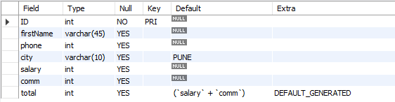
default value
col_name data_type DEFAULT value
The DEFAULT specifies a default value for the column.
CREATE TABLE posts (
postID INT,
postTitle VARCHAR(255),
postDate DATETIME DEFAULT NOW(),
deleted INT
);
# version 8.0 and above.
CREATE TABLE empl (
ID INT PRIMARY KEY,
firstName VARCHAR(45),
phone INT,
city VARCHAR(10) DEFAULT 'PUNE',
salary INT,
comm INT,
total INT DEFAULT(salary + comm)
);

Slide 77
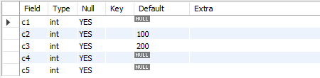
default value - insert
The DEFAULT example.
CREATE TABLE temp (
c1 INT,
c2 INT DEFAULT 100,
c3 INT DEFAULT 200,
c4 INT,
c5 INT
);
INSERT INTO temp VALUES();
INSERT INTO temp(c1, c2, c3, c4, c5) VALUES(1, DEFAULT, DEFAULT, 1, 1);
INSERT INTO temp(c1, c2, c3, c4, c5) VALUES(2, DEFAULT(c2), DEFAULT(c3), 2, 2);
INSERT INTO temp(c1, c2, c3, c4, c5) VALUES(3, DEFAULT(c3), DEFAULT(c2), 3, 3);

Slide 78
default value - update
The DEFAULT example.
CREATE TABLE temp (
c1 INT,
c2 INT,
c3 INT DEFAULT(c1 + c2),
c4 INT DEFAULT(c1 * c2 )
);
INSERT INTO temp(c1, c2, c3, c4) VALUES(1, 1, 1, 1);
INSERT INTO temp(c1, c2, c3, c4) VALUES(2, 2, 2, 2);
UPDATE temp SET c3 = DEFAULT;
UPDATE temp SET c4 = DEFAULT;

Slide 79
Note:
Your database table has X columns, Where as the VALUES you are passing are for (X-1) or (X+1). This mismatch of column-values will giving you the error.
Inserting a string into a string column (CHAR, VARCHAR, TEXT, or BLOB) that exceeds the column maximum length. The value is truncated to the column maximum length.
insert rows
INSERT command inserts new rows into an existing table.
You can insert data using following methods:
INSERT ... VALUES
INSERT ... SET
INSERT ... SELECT

Slide 80
insert rows using values

Slide 81
dml- insert … values
INSERT inserts new rows into an existing table. The INSERT ... VALUES
INSERT [IGNORE] [INTO] tbl_name [PARTITION (partition_name [, partition_name] ...)] [ (col_name, . . .) ] { VALUES | VALU E } ( { expr | DEFAULT }, . . .), (. . .), . . . [ ON DUPLICATE KEY UPDATE assignment_list ]
The affected-rows value for an INSERT can be obtained using the ROW_COUNT() function.
Column Values
Column List
Inserting multiple rows

Slide 82
dml- insert … values
INSERT inserts new rows into an existing table. The INSERT ... VALUES
INSERT [IGNORE] [INTO] tbl_name [PARTITION (partition_name [, partition_name] ...)] [ (col_name, . . .) ] { VALUES | VALUE } [ROW] ( { expr | DEFAULT }, . . .), [ROW] (. . .), [ROW] . . . [ ON DUPLICATE KEY UPDATE assignment_list ]
CREATE TABLE student (
ID INT PRIMARY KEY,
nameFirst VARCHAR(45),
nameLast VARCHAR(45),
DoB DATE ,
emailID VARCHAR(128)
);
e.g.
INSERT INTO student VALUES (29, 'sharmin', 'patil', '1999-11-10', 'sharmin.patil@gmail.com’);
INSERT INTO student (ID, nameFirst, nameLast, DOB, emailID) VALUES (30, 'john', 'thomas', '1983-11-10', 'john.thomas@gmail.com’);
INSERT INTO student (ID, nameFirst, emailID) VALUES (31, 'jack', 'jack.thorn@gmail.com’);
INSERT INTO student (ID, nameFirst) VALUES (32, 'james'), (33, 'jr. james'), (34, 'sr. james');

Slide 83
insert rows using select

Slide 84
insert ... select
With INSERT ... SELECT, you can quickly insert many rows into a table from one or many tables.
INSERT [INTO] tbl_name [(col_name, . . .)] SELECT . . .
INSERT INTO dept(deptno) SELECT 1 + 1;
INSERT INTO dept(deptno) SELECT deptno FROM dept;
INSERT INTO dept SELECT * FROM dept;
INSERT INTO dept(SELECT MAX(deptno) + 1, 'HRD', 'BARODA', 'r57px33px' FROM dept);
set @x := 40;
INSERT INTO dept VALUES (@x := @x + 1 , 'HRD', 'BARODA', 'r57px33px');
set @x := (SELECT MAX(deptno) FROM dept);
INSERT INTO dept VALUES (@x := @x + 1 , 'HRD', 'BARODA', 'r57px33px');

Slide 85
Do not use the * operator in your SELECT statements. Instead, use column names. Reason is that in MySQL Server scans for all column names and replaces the * with all the column names of the table(s) in the SELECT statement. Providing column names avoids this search-and-replace, and enhances performance.
SELECT statement…
SELECT what_to_select
FROM which_table
WHERE conditions_to_satisfy;

Slide 86
SELECT CLAUSE
The SELECT statement retrieves or extracts data from tables in the database.
You can use one or more tables separated by comma to extract data.
You can fetch one or more fields/columns in a single SELECT command.
You can specify star (*) in place of fields. In this case, SELECT will return all the fields.
SELECT can also be used to retrieve rows computed without reference to any table e.g. SELECT 1 + 2;

Slide 87
Capabilities of SELECT Statement
SELECTION
PROJECTION
JOINING

Slide 88
Capabilities of SELECT Statement
SELECTION
Selection capability in SQL is to choose the rows in a table that you want to return by a query.
R
EMPNO | ENAME | JOB | HIREDATE | DEPTNO
1 | Saleel | Manager | 1995-01-01 | 10
2 | Janhavi | Sales | 1994-12-20 | 20
3 | Snehal | Manager | 1997-05-21 | 10
4 | Rahul | Account | 1997-07-30 | 10
5 | Ketan | Sales | 1994-01-01 | 30

Slide 89
Capabilities of SELECT Statement
PROJECTION
Projection capability in SQL to choose the columns in a table that you want to return by your query.
R
EMPNO | ENAME | JOB | HIREDATE | DEPTNO
1 | Saleel | Manager | 1995-01-01 | 10
2 | Janhavi | Sales | 1994-12-20 | 20
3 | Snehal | Manager | 1997-05-21 | 10
4 | Rahul | Account | 1997-07-30 | 10
5 | Ketan | Sales | 1994-01-01 | 30

Slide 90
Capabilities of SELECT Statement
JOINING
Join capability in SQL to bring together data that is stored in different tables by creating a link between them.
R
S
EMPNO | ENAME | JOB | HIREDATE | DEPTNO
1 | Saleel | Manager | 1995-01-01 | 20
2 | Janhavi | Sales | 1994-12-20 | 10
3 | Snehal | Manager | 1997-05-21 | 10
4 | Rahul | Account | 1997-07-30 | 20
5 | Ketan | Sales | 1994-01-01 | 30
DEPTNO | DNAME | LOC
10 | HRD | PUNE
20 | SALES | BARODA
40 | PURCHASE | SURAT

Slide 91
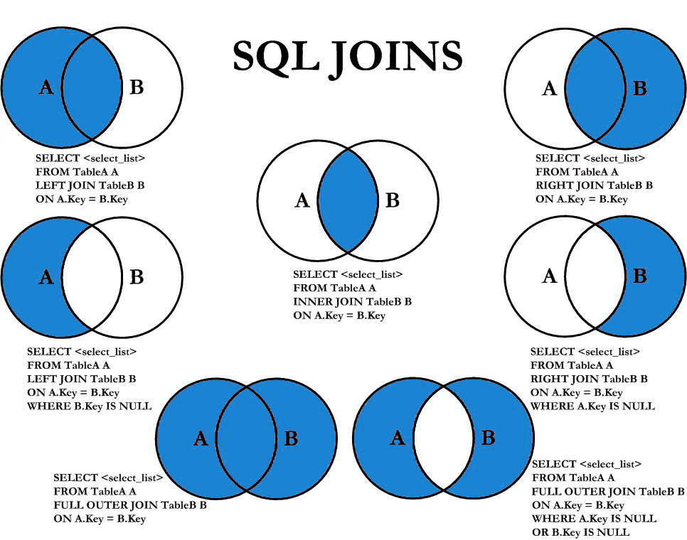

Slide 92
select statement
SELECTION Process
SELECT * FROM <table_references>
selection-list | field-list | column-list
Remember:
Here, " * " is known as metacharacter (all columns)
PROJECTION Process
SELECT column-list FROM <table_references>
selection-list | field-list | column-list
Remember:
Position of columns in SELECT statement will determine the position of columns in the output (as per user requirements)

Slide 93
ORDER BY in UPDATE: if the table contains two values 1 and 2 in the id column and 1 is updated to 2 before 2 is updated to 3, an error occurs. To avoid this problem, add an ORDER BY clause to cause the rows with larger id values to be updated before those with smaller values.
Note:
Here c1 column is a Primary Key
UPDATE temp SET c1 = c1 - 1 ORDER BY c1 ASC; # In case of decrement
UPDATE temp SET c1 = c1 + 1 ORDER BY c1 DESC; # In case of increment
In a SET statement, = is treated identically to :=
single-table update
SET @x := 0;
UPDATE emp SET id = @x := @x + 1;
UPDATE t, (SELECT isactive, COUNT(isactive) r1 FROM emp GROUP BY isactive) a SET t.c2 = a.r1 WHERE t.c1 = a.isactive;
mysql> SELECT * FROM t;
+-------+--------+
| c1 | c2 |
+-------+--------+
| 0 | NULL |
| 1 | NULL |
+-------+--------+
+-------+------+
| c1 | c2 |
+-------+------+
| 0 | 6 |
| 1 | 14 |
+-------+------+
e.g.
Update top 2 rows.
Update UnitPrice for the top 5 most expensive products.

Slide 94
single-table update
The UPDATE statement updates columns of existing rows in the named table with new values. The SET clause indicates which columns to modify and the values they should be given. The WHERE clause, if given, specifies the conditions that identify which rows to update. With no WHERE clause, all rows are updated. If the ORDER BY clause is specified, the rows are updated in the order that is specified. The LIMIT clause places a limit on the number of rows that can be updated.
UPDATE tbl_name SET col_name1 = { expr1 | DEFAULT } [, col_name2 = { expr2 | DEFAULT } ] . . .
[WHERE where_condition]
[ORDER BY . . .]
[LIMIT row_count]
UPDATE temp SET dname = 'new_value' LIMIT 2;
UPDATE temp SET c1 = 'new_value' ORDER BY loc LIMIT 2;
UPDATE temp SET c1 := 'new_value' WHERE deptno < 50;
UPDATE temp SET c1 := 'new_value' WHERE deptno < 50 LIMIT 2;
ALTER TABLE dept ADD SUMSALARY INT;
UPDATE dept SET sumsalary = (SELECT SUM(sal) FROM emp WHERE emp.deptno = dept.deptno GROUP BY emp.deptno);
UPDATE candidate SET totalvotes = (SELECT COUNT(*) FROM votes WHERE candidate.id = votes.candidateID GROUP BY votes.candidateID);
UPDATE duplicate SET id = ( SELECT @cnt := @cnt + 1 );

Slide 95
single-table delete

Slide 96
single-table delete
The DELETE statement deletes rows from tbl_name and returns the number of deleted rows. To check the number of deleted rows, call the ROW_COUNT() function. The optional WHERE clause identify which rows to delete. With no WHERE clause, all rows are deleted. If the ORDER BY clause is specified, the rows are deleted in the order that is specified. The LIMIT clause places a limit on the number of rows that can be deleted.
DELETE FROM tbl_name
[PARTITION (partition_name [, partition_name] . . .)]
[WHERE where_condition]
[ORDER BY . . .]
[LIMIT row_count]
Note:
LIMIT clauses apply to single-table deletes, but not multi-table deletes.
DELETE FROM temp;
DELETE FROM temp ORDER BY loc LIMIT 2;
DELETE FROM temp WHERE deptno < 50;
DELETE FROM temp WHERE deptno < 50 LIMIT 2;

Slide 97
auto_increment column
The AUTO_INCREMENT attribute can be used to generate a unique number/identity for new rows.

Slide 98
auto_increment
IDENTITY is a synonym to the LAST_INSERT_ID variable.
col_name data_type AUTO_INCREMENT [UNIQUE [KEY] | [PRIMARY] KEY]
Remember:
There can be only one AUTO_INCREMENT column per table.
it must be indexed.
it cannot have a DEFAULT value.
it works properly only if it contains only positive values.
It applies only to integer and floating-point types.
when you insert a value of NULL or 0 into AUTO_INCREMENT column, it generates next value.
use LAST_INSERT_ID() function to find the row that contains the most recent AUTO_INCREMENT value.
SELECT @@IDENTITY
SELECT LAST_INSERT_ID()
SET INSERT_ID = 7
CREATE TABLE posts (
c1 INT UNIQUE KEY AUTO_INCREMENT,
c2 VARCHAR(20)
) AUTO_INCREMENT = 2; // auto_number will start with value 2.

Slide 99
CREATE TABLE . . . LIKE . . ., the destination table preserves generated column information from the original table.
CREATE TABLE . . . SELECT . . ., the destination table does not preserves generated column information from the original table.
generated column
Remember:
Stored functions and user-defined functions are not permitted.
Stored procedure and function parameters are not permitted.
Variables (system variables, user-defined variables, and stored program local variables) are not permitted.
Subqueries are not permitted.
The AUTO_INCREMENT attribute cannot be used in a generated column definition.
Triggers cannot use NEW.COL_NAME or use OLD.COL_NAME to refer to generated columns.
Stored column cannot be converted to virtual column and virtual column cannot be converted to stored column.
Generated column can be made as invisible column.
Note:
The expression can contain literals, built-in functions with no parameters, operators, or references to any column within the same table. If you use a function, it must be scalar and deterministic.

Slide 100
visible / invisible columns
Columns are visible by default. To explicitly specify visibility for a new column, use a VISIBLE or INVISIBLE keyword as part of the column definition for CREATE TABLE or ALTER TABLE.
Note:
An invisible column is normally hidden to queries, but can be accessed if explicitly referenced. Prior to MySQL 8.0.23, all columns are visible.
A table must have at least one visible column. Attempting to make all columns invisible produces an error.
SELECT * does not include invisible columns.

Slide 101
invisible column
col_name data_type INVISIBLE
CREATE TABLE employee (
ID INT AUTO_INCREMENT PRIMARY KEY,
firstName VARCHAR(40),
salary INT,
commission INT,
total INT DEFAULT(salary + commission) INVISIBLE
tax INT GENERATED ALWAYS AS (total * .25) VIRTUAL INVISIBLE
) ;
CREATE TABLE employee (
ID INT PRIMARY KEY AUTO_INCREMENT INVISIBLE ,
firstName VARCHAR(40)
) ;
INSERT INTO employee(firstName, salary, commission) VALUES('ram', 4700, -700);
INSERT INTO employee(firstName, salary, commission) VALUES('pankaj', 3400, NULL);
INSERT INTO employee(firstName, salary, commission) VALUES('rajan', 3200, 250);
INSERT INTO employee(firstName, salary, commission) VALUES('ninad', 2600, 0);
INSERT INTO employee(firstName, salary, commission) VALUES('omkar', 4500, 300);
SELECT * FROM employee;
ALTER TABLE employee MODIFY total INT VISIBLE;
ALTER TABLE employee MODIFY total INT INVISIBLE;

Slide 102
varbinary column
TODO
Note:
TODO
TODO
TODO

Slide 103
varbinary column
col_name VARBINARY
CREATE TABLE login (
ID INT AUTO_INCREMENT PRIMARY KEY,
userName VARCHAR(40),
password VARBINARY(40) INVISIBLE
) ;
INSERT INTO login(userName, password) VALUES('ram', 'ram@123');
INSERT INTO login(userName, password) VALUES('pankaj', 'pankaj');
INSERT INTO login(userName, password) VALUES('rajan', 'rajan');
INSERT INTO login(userName, password) VALUES('ninad', 'ninad');
INSERT INTO login(userName, password) VALUES('omkar', 'omkar');
SELECT * FROM login;
SELECT username, CAST(password as CAST) FROM login;

Slide 104
constraints
CONSTRAINT is used to define rules to allow or restrict what values can be stored in columns. The purpose of inducing constraints is to enforce the integrity of a database.
CONSTRAINTS can be classified into two types –
Column Level
Table Level
The column level constraints can apply only to one column where as table level constraints are applied to the entire table.

Slide 105
Remember:
PRI => primary key
UNI => unique key
MUL=> is basically an index that is neither a primary key nor a unique key. The name comes from
"multiple" because multiple occurrences of the same value are allowed.
constraints
To limit or to restrict or to check or to control.
Note:
a table with a foreign key that references another table's primary key is MUL.
If more than one of the Key values applies to a given column of a table, Key displays the one with the highest priority, in the order PRI, UNI, and MUL.

Slide 106
Keys are used to establish relationships between tables and also to uniquely identify any record in the table.
types of Keys?
r = Employee(EmployeeID, FullName, job, salary, PAN, DateOfBirth, emailID, deptno)
Candidate Key: are individual columns in a table that qualifies for uniqueness of all the rows. Here in Employee table EmployeeID, PAN or emailID are Candidate keys.
Primary Key: is the columns you choose to maintain uniqueness in a table. Here in Employee table you can choose either EmployeeID, PAN or emailID columns, EmployeeID is preferable choice.
Alternate Key: Candidate column other the primary key column, like if EmployeeID is primary key then , PAN or emailID columns would be the Alternate key.
Super Key: If you add any other column to a primary key then it become a super key, like EmployeeID + FullName is a Super Key.
Composite Key: If a table do not have any single column that qualifies for a Candidate key, then you have to select 2 or more columns to make a row unique. Like if there is no EmployeeID, PAN or emailID columns, then you can make FullName + DateOfBirth as Composite key. But still there can be a narrow chance of duplicate row.

Slide 107
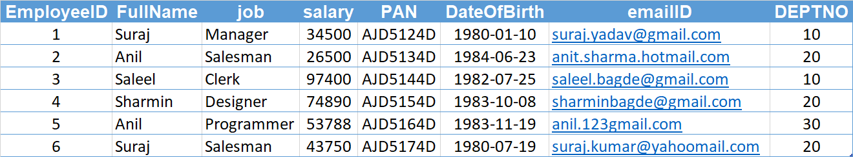
Candidate Key
Primary Key
Composite Key
Alternate Key

Slide 108
Remember:
A primary key cannot be NULL.
A primary key value must be unique.
A table has only one primary key.
The primary key values cannot be changed, if it is referred by some other column.
The primary key must be given a value when a new record is inserted.
An index can consist of 16 columns, at maximum. Since a PRIMARY KEY constraint automatically adds an index, it can't have more than 16 columns.
PRIMARY KEY constraint
Choosing a primary key is one of the most important steps in good database design. A primary key is a column that serves a special purpose. A primary key is a special column (or set of combined columns) in a relational database table, that is used to uniquely identify each record. Each database table needs a primary key.
Note:
Primary key in a relation is always associated with an INDEX object.
If, we give on a column a combination of NOT NULL & UNIQUE key then it behaves like a PRIMARY key.
If, we give on a column a combination of UNIQUE key & AUTO_INCREMENT then also it behaves like a PRIMARY key.

Slide 109
clustered and non-clustered index
Indexing in MySQL is a process that helps us to return the requested data from the table very fast. If the table does not have an index, it scans the whole table for the requested data.
MySQL allows two different types of Indexing:
Clustered Index
Non-Clustered Index
Clustered Index:- The InnoDB table uses a clustered index for optimizing the speed of most common lookups ( SELECT statement) and DML operations like INSERT, UPDATE, and DELETE command. Clustered indexes sort and store the data rows in the table based on their key values that can be sorted in only one way. If the table column contains a primary key or unique key, MySQL creates a clustered index named PRIMARY based on that specific column.
Non-Clustered Index:- The indexes other than PRIMARY indexes (i.e. clustered indexes) called a non-clustered index. The non-clustered indexes are also known as secondary indexes. The non-clustered index and table data are both stored in different places. It is not sorted (ordering) the table data.
CREATE TABLE test(c1 INT, c2 INT, c3 INT, c4 INT,c5 INT, c6 INT, c7 INT, c8 INT, c9 INT, c10 INT, c11 INT, c12 INT, c13 INT, c14 INT, c15 INT, c16 INT, c17 INT, c18 INT, c19 INT, c20 INT, PRIMARY KEY (c1, c2, c3, c4, c5, c6, c7, c8, c9, c10, c11, c12, c13, c14, c15, c16, c17, c18 )); // error

Slide 110
constraints – add primary key
col_name data_type PRIMARY KEY
The following example creates tables with PRIMARY KEY column.
CREATE TABLE users (
ID INT PRIMARY KEY,
userName VARCHAR(25),
password VARCHAR(25),
email VARCHAR(255)
) ;
CREATE TABLE purchase_orders (
po_number INT,
vendor_id INT NOT NULL,
po_status INT NOT NULL,
PRIMARY KEY(po_number)
);
CREATE TABLE supplier (
supplier_id INT,
supplier_name VARCHAR(50),
contact_name VARCHAR(50),
constraint pk_supplier_id PRIMARY KEY(supplier_id)
);
CREATE TABLE person (
ID INT NOT NULL UNIQUE,
lastName VARCHAR(45),
firstName VARCHAR(45),
age INT,
email VARCHAR(255)
);

Slide 111
constraints – add composite primary key
The following example creates tables with COMPOSITE PRIMARY KEY column.
CREATE TABLE salesDetails (
customerID INT,
productID INT,
timeID INT,
qty INT,
salesDate DATE,
salesAmount INT,
PRIMARY KEY(customerID , productID, timeID)
) ;
customerID | productID | timeID | quantity | salesDate | salesAmount
Cust-001 | PRD-1 | D1-T1 | 100 | ●●●●●● | 25,00,000
Cust-001 | PRD-1 | D2-T1 | 100 | ●●●●●● | 25,00,000
Cust-001 | PRD-2 | D1-T1 | 200 | ●●●●●● | 50,00,000
Cust-002 | PRD-1 | D1-T1 | 100 | ●●●●●● | 25,00,000
Cust-004 | PRD-1 | D1-T1 | 100 | ●●●●●● | 25,00,000
Cust-004 | PRD-2 | D3-T1 | 200 | ●●●●●● | 50,00,000

Slide 112
constraints – add composite primary key
The following example creates tables with COMPOSITE PRIMARY KEY column.
CREATE TABLE payments (
paymentID INT,
orderID INT,
amount INT,
bankDetails VARCHAR(255),
PRIMARY KEY(paymentID , orderID)
) ;
CREATE TABLE order_product (
orderID INT,
productID INT,
qty INT,
rate INT,
constraint pk_orderID_productID PRIMARY KEY(orderID, productID)
) ;

Slide 113
ALTER TABLE table_name
ADD [ CONSTRAINT constraint_name ]
PRIMARY KEY (column1, column2, . . . column_n)
Add Primary Key using Alter

Slide 114
constraints – add primary key using alter
You can use the ALTER TABLE statement to ADD PRIMARY KEY on existing column.
ALTER TABLE table_name
ADD [ CONSTRAINT constraint_name ]
PRIMARY KEY (column1, column2, . . . column_n)
CREATE TABLE vendors (
vendor_id INT,
vendor_name VARCHAR(25),
address VARCHAR(255)
);
ALTER TABLE vendors ADD PRIMARY KEY(vendor_id);
ALTER TABLE vendors ADD constraint pk_vendor_id PRIMARY KEY(vendor_id);

Slide 115
ALTER TABLE table_name
DROP PRIMARY KEY
Drop Primary Key

Slide 116
constraints – drop primary key
You can use the ALTER TABLE statement to DROP PRIMARY KEY.
ALTER TABLE table_name
DROP PRIMARY KEY
CREATE TABLE vendors (
vendor_id INT,
vendor_name VARCHAR(25),
address VARCHAR(255)
);
ALTER TABLE vendors DROP PRIMARY KEY;

Slide 117
Remember:
A unique key can be NULL.
A unique key value must be unique.
A table can have multiple unique key.
A column can have unique key as well as a primary key.
UNIQUE KEY constraint
A UNIQUE key constraint is a set of one or more than one fields/columns of a table that uniquely identify a record in a database table.
Note:
Unique key in a relation is always associated with an INDEX object.

Slide 118
constraints – add unique key
col_name data_type UNIQUE KEY
The following example creates table with UNIQUE KEY column.
CREATE TABLE clients (
client_id INT,
first_name VARCHAR(50),
last_name VARCHAR(50),
company_name VARCHAR(255),
email VARCHAR(255) UNIQUE
);
CREATE TABLE contacts (
ID INT,
first_name VARCHAR(50),
last_name VARCHAR(50),
phone VARCHAR(15),
UNIQUE(phone)
);
CREATE TABLE brands (
ID INT,
brandName VARCHAR(30),
constraint uni_brandName UNIQUE(brandName)
);
SHOW INDEX FROM clients;

Slide 119
ALTER TABLE table_name
ADD [ CONSTRAINT constraint_name ]
UNIQUE (column1, column2, . . . column_n)
Add Unique Key using Alter

Slide 120
constraints – add unique key using alter
You can use the ALTER TABLE statement to ADD UNIQUE KEY on existing column.
ALTER TABLE table_name
ADD [ CONSTRAINT constraint_name ]
UNIQUE (column1, column2, . . . column_n)
CREATE TABLE shop (
ID INT,
shop_name VARCHAR(30)
);
ALTER TABLE shop ADD UNIQUE(shop_name);
ALTER TABLE shop ADD constraint uni_shop_name UNIQUE(shop_name);

Slide 121
ALTER TABLE table_name
DROP INDEX constraint_name;
Drop Unique Key

Slide 122
constraints – drop unique key
You can use the ALTER TABLE statement to DROP UNIQUE KEY.
ALTER TABLE table_name
DROP INDEX constraint_name;
SELECT table_name, constraint_name, constraint_type FROM information_schema.table_constraints WHERE constraint_schema = 'z' AND table_name IN ('A', 'B');
ALTER TABLE users DROP INDEX <COLUMN_NAME>;
ALTER TABLE users DROP INDEX U_USER_ID; #CONSTRAINT NAME
CREATE TABLE users (
ID INT PRIMARY KEY,
userName VARCHAR(40),
password VARCHAR(255),
email VARCHAR(255) UNIQUE KEY
) ;
CREATE TABLE users (
ID INT PRIMARY KEY,
userName VARCHAR(40),
password VARCHAR(255),
email VARCHAR(255),
constraint uni_email UNIQUE KEY(email)
) ;
ALTER TABLE users DROP INDEX email;
ALTER TABLE users DROP INDEX uni_email;

Slide 123
FOREIGN KEY constraint
A FOREIGN KEY is a key used to link two tables together. A FOREIGN KEY is a field (or collection of fields) in one table that refers to the PRIMARY KEY in another table. The table containing the foreign key is called the child table, and the table containing the candidate key is called the referenced or parent table.

Slide 124
constraints – foreign key
Remember:
A foreign key can have a different column name from its primary key.
DataType of primary key and foreign key column must be same.
It ensures rows in one table have corresponding rows in another.
Unlike the Primary key, they do not have to be unique.
Foreign keys can be null even though primary keys can not.
Note:
The table containing the FOREIGN KEY is referred to as the child table, and the table containing the PRIMARY KEY (referenced key) is the parent table.
PARENT and CHILD tables must use the same storage engine,
and they cannot be defined as temporary tables.

Slide 125
insert, update, & delete – (primary key/foreign key)
A referential constraint could be violated in following cases.
An INSERT attempt to add a row to a child table that has a value in its foreign key columns that does not match a value in the corresponding parent table's column.
An UPDATE attempt to change the value in a child table's foreign key columns to a value that has no matching value in the corresponding parent table's parent key.
An UPDATE attempt to change the value in a parent table's parent key to a value that does not have a matching value in a child table's foreign key columns.
A DELETE attempt to remove a record from a parent table that has a matching value in a child table's foreign key columns.
Note:
PARENT and CHILD tables must use the same storage engine,
and they cannot be defined as temporary tables.
If we don’t give constraint name. System will automatically generated the constraint name and will assign to foreign key constraint. e.g. login_ibfk_1, login_ibfk_2, …..

Slide 126
anomaly – (primary key/foreign key)
Remember:
Student (parent) Table
student_course (child) Table
RollNo | Name | Mobile | City | State | isActive
1 | Ramesh | ●●●● | Pune | MH | 1
2 | Amit | ●●●● | Baroda | GJ | 1
3 | Rajan | ●●●● | Surat | GJ | 1
4 | Bhavin | ●●●● | Baroda | GJ | 1
5 | Pankaj | ●●●● | Surat | GJ | 1
RollNo | CourceDuration | CourceName
1 | 1.5 month | RDBMS
2 | 1.2 month | NoSQL
3 | 2 month | Networking
1 | 2 month | Java
2 | 2 month | .NET
Insertion anomaly:
If we try to insert a record in Student_Course (child) table with RollNo = 7, it will not allow.
Updation and Deletion anomaly:
If you try to chance the RollNo from Student (parent) table with RollNo = 6 whose RollNo = 1 , it will not allow.
If you try to chance the RollNo from Student_Course (child) table with RollNo = 9 whose RollNo = 3 , it will not allow.
If we try to delete a record from Student (parent) table with RollNo = 1, it will not allow.

Slide 127
alter, drop – (primary key/foreign key)
Remember:
Parent Table
student = {
rollno INT, * (PK)
name VARCHAR(10),
mobile VARCHAR(10),
city VARCHAR(10),
state VARCHAR(10),
isActive BOOL
}
Child Table
student_course = {
rollno INT, * (FK)
courceduration VARCHAR(10),
courcename VARCHAR(10)
}
DDL command could be violated in following cases.
Alter command:
If we try to modify datatype of RollNo in Student or Student_Course table with VARCHAR, it will not allow.
If we try to apply auto_increment to RollNo in Student table, it will not allow
If we try to drop RollNo column from Student table , it will not allow.
Drop command:
If we try to drop Student (parent) table, it will not allow.

Slide 128
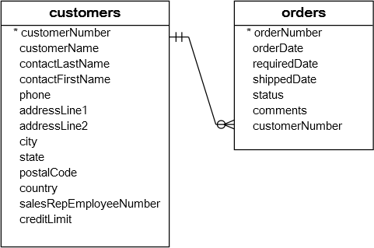
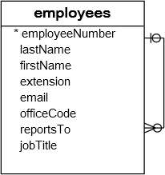
constraints – foreign key
A foreign key is a field in a table that matches another field of another table. A foreign key places constraints on data in the related tables, which enables MySQL to maintain referential integrity.
The customers table is called parent table or referenced table, and the orders table is known as child table or referencing table.

Slide 129
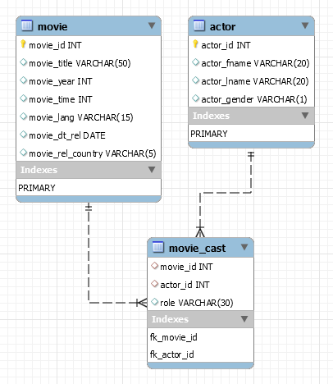
constraints – foreign key
A foreign key is a field in a table that matches another field of another table. A foreign key places constraints on data in the related tables, which enables MySQL to maintain referential integrity.
CREATE TABLE movie (
movie_id INT PRIMARY KEY,
movie_title VARCHAR(50),
movie_year INT,
movie_time INT,
movie_lang VARCHAR(15),
movie_dt_rel DATE,
movie_rel_country VARCHAR(5)
);
CREATE TABLE actor (
actor_id INT PRIMARY KEY,
actor_fname VARCHAR(20),
actor_lname VARCHAR(20),
actor_gender VARCHAR(1)
);
CREATE TABLE movie_cast (
movie_id INT,
actor_id INT,
role VARCHAR(30),
constraint fk_movie_id FOREIGN KEY(movie_id) REFERENCES movie(movie_id),
constraint fk_actor_id FOREIGN KEY(actor_id) REFERENCES actor(actor_id)
);

Slide 130
QUESTION – find foreign key columns
The following example find Foreign Key columns.
CREATE TABLE owner (
owner_id INT PRIMARY KEY,
first_name VARCHAR(50),
last_name VARCHAR(50),
email VARCHAR(255)
);
CREATE TABLE contacts (
contact_id INT PRIMARY KEY,
owner_id INT,
contact_number VARCHAR(15)
);
CREATE TABLE shop (
shop_id INT,
owner_id INT,
shop_name VARCHAR(30)
);
CREATE TABLE shop_brand (
ID INT PRIMARY KEY,
shop_id INT,
brand_id INT
);
CREATE TABLE brands (
brand_id INT PRIMARY KEY,
brand_name VARCHAR(30) UNIQUE
);

Slide 131
ALTER TABLE table_name
ADD [ CONSTRAINT constraint_name ]
FOREIGN KEY (child_col1, child_col2, . . . child_col_n)
REFERENCES parent_table (parent_col1, parent_col2, . . . parent_col_n);
Add Foreign Key Constraint using Alter

Slide 132
constraints – add foreign key using alter
You can use the ALTER TABLE statement to ADD FOREIGN KEY on existing column.
ALTER TABLE table_name
ADD [ CONSTRAINT constraint_name ]
FOREIGN KEY (child_col1, child_col2, . . . child_col_n)
REFERENCES parent_table (parent_col1, parent_col2, . . . parent_col_n);
CREATE TABLE users (
ID INT PRIMARY KEY,
userName VARCHAR(40),
password VARCHAR(255),
email VARCHAR(255) UNIQUE KEY
) ;
CREATE TABLE login (
ID INT PRIMARY KEY,
userID INT,
loginDate DATE,
loginTime TIME
) ;
ALTER TABLE login ADD FOREIGN KEY(userID) REFERENCES users(ID);
ALTER TABLE login ADD constraint fk_userID FOREIGN KEY(userID) REFERENCES users(ID);

Slide 133
ALTER TABLE table_name
DROP FOREIGN KEY constraint_name
Drop Foreign Key Constraint using Alter

Slide 134
constraints – drop foreign key
You can use the ALTER TABLE statement to DROP FOREIGN KEY.
CREATE TABLE users (
ID INT PRIMARY KEY ,
userName VARCHAR(40),
password VARCHAR(255),
email VARCHAR(255)
) ;
CREATE TABLE login (
ID INT PRIMARY KEY,
userID INT,
loginDate DATE,
loginTime TIME,
FOREIGN KEY(userID) REFERENCES users(ID)
) ;
CREATE TABLE login (
ID INT PRIMARY KEY,
userID INT,
loginDate DATE,
loginTime TIME,
constraint fk_userID FOREIGN KEY(userID) REFERENCES users(ID)
) ;
ALTER TABLE login DROP FOREIGN KEY fk_userID;
ALTER TABLE login DROP FOREIGN KEY login_ibfk_1; // login_ibfk_1 is the default constraint name.
SELECT table_name, constraint_name, constraint_type FROM information_schema.table_constraints WHERE table_schema = 'DB2’;

Slide 135
constraints – foreign key
[ON DELETE reference_option]
[ON UPDATE reference_option]
reference_option: RESTRICT | CASCADE | SET NULL | NO ACTION | SET DEFAULT
Cascaded FOREIGN KEY actions do not activate triggers.
Remember:
When an UPDATE or DELETE operation affects a key value in the parent table that has matching rows in the child table, the result depends on the referential action specified using ON UPDATE and ON DELETE sub clauses of the FOREIGN KEY clause.
ON DELETE or ON UPDATE that is not specified, the default action is always RESTRICT.

Slide 136
constraints – foreign key
Remember:
CASCADE: Delete or update the row from the parent table, and automatically delete or update the matching rows in the child table. Both ON DELETE CASCADE and ON UPDATE CASCADE are supported.
SET NULL: Delete or update the row from the parent table, and set the foreign key column or columns in the child table to NULL. Both ON DELETE SET NULL and ON UPDATE SET NULL clauses are supported.
CREATE TABLE users (
ID INT PRIMARY KEY ,
userName VARCHAR(40),
password VARCHAR(255),
email VARCHAR(255)
) ;
CREATE TABLE login (
ID INT PRIMARY KEY,
userID INT,
loginDate DATE,
loginTime TIME,
FOREIGN KEY(userID) REFERENCES users(ID) ON DELETE CASCADE
) ;
CREATE TABLE login (
ID INT PRIMARY KEY,
userID INT,
loginDate DATE,
loginTime TIME,
FOREIGN KEY(userID) REFERENCES users(ID) ON UPDATE CASCADE
) ;

Slide 137
on delete / on update – foreign key
SET NULL: Delete or update the row from the parent table and set the foreign key column or columns in the child table to NULL. If you specify a SET NULL action, make sure that you have not declared the columns in the child table as NOT NULL.
RESTRICT: Rejects the delete or update operation for the parent table. Specifying RESTRICT (or NO ACTION) is the same as omitting the ON DELETE or ON UPDATE clause.
NO ACTION: Is equivalent to RESTRICT. The MySQL Server rejects the delete or update operation for the parent table if there is a related foreign key value in the referenced table.
SET DEFAULT: This action is recognized by the MySQL parser, but both InnoDB and NDB reject table definitions containing ON DELETE SET DEFAULT or ON UPDATE SET DEFAULT clauses.

Slide 138






CREATE TABLE test (c1 INT, c2 INT, c3 INT, check (c3 = SUM(c1)));
// ERROR
Check Constraint

Slide 139
constraints – check
CHECK condition expressions must follow some rules.
Literals, deterministic built-in functions, and operators are permitted.
Non-generated and generated columns are permitted, except columns with the AUTO_INCREMENT attribute.
Sub-queries are not permitted.
Environmental variables (such as CURRENT_USER, CURRENT_DATE, …) are not permitted.
Non-Deterministic built-in functions (such as AVG, COUNT, RAND, LAST_INSERT_ID, FIRST_VALUE, LAST_VALUE, ...) are not permitted.
Variables (system variables, user-defined variables, and stored program local variables) are not permitted.
Stored functions and user-defined functions are not permitted.
Note:
Prior to MySQL 8.0.16, CREATE TABLE permits only the following limited version of table CHECK constraint syntax, which is parsed and ignored.
Remember:
If you omit the constraint name, MySQL automatically generates a name with the following convention:
table_name_chk_n

Slide 140
constraints – check
col_name data_type CHECK(expr)
The following example creates USERS table with CHECK column.
CREATE TABLE users (
ID INT PRIMARY KEY,
userName VARCHAR(40),
password VARCHAR(255),
email VARCHAR(255),
ratings INT CHECK(ratings > 50)
) ;
CREATE TABLE users (
ID INT PRIMARY KEY,
userName VARCHAR(40),
password VARCHAR(255),
email VARCHAR(255),
ratings INT,
CHECK(ratings > 50)
) ;
CREATE TABLE users (
ID INT PRIMARY KEY,
userName VARCHAR(40),
password VARCHAR(255),
email VARCHAR(255),
ratings INT,
constraint chk_ratings CHECK(ratings > 50)
) ;
CREATE TABLE users (
ID INT PRIMARY KEY,
userName VARCHAR(40),
password VARCHAR(255),
email VARCHAR(255),
ratings INT,
constraint chk_ratings CHECK(ratings > 50),
constraint chk_email CHECK(LENGTH(email) > 12)
) ;

Slide 141
constraints – check
col_name data_type CHECK(expr)
The following example creates USERS table with CHECK column.
CREATE TABLE users (
ID INT PRIMARY KEY,
startDate DATE,
endDate DATE,
constraint chk_endDate CHECK(endDate > startDate + INTERVAL 7 day)
) ;
SELECT * FROM check_constraints WHERE CONSTRAINT_SCHEMA = 'z';

Slide 142
ALTER TABLE table_name
ADD [ CONSTRAINT constraint_name ]
CHECK (conidiation)
Add Check Constraint using Alter

Slide 143
constraints – add check using alter
You can use the ALTER TABLE statement to ADD CHECK KEY on existing column.
ALTER TABLE table_name
ADD CONSTRAINT [ constraint_name ]
CHECK (conidiation)
CREATE TABLE users (
ID INT PRIMARY KEY,
userName VARCHAR(40),
password VARCHAR(255),
email VARCHAR(255),
ratings INT
) ;
ALTER TABLE users ADD CHECK(ratings > 50);
ALTER TABLE users ADD constraint chk_ratings CHECK(ratings > 50);

Slide 144
ALTER TABLE table_name
DROP CHECK [ CONSTRAINT ] constraint_name
drop check constraint

Slide 145
constraints – drop check key
You can use the ALTER TABLE statement to DROP CHECK KEY.
CREATE TABLE users (
ID INT PRIMARY KEY,
userName VARCHAR(40),
password VARCHAR(255),
email VARCHAR(255),
ratings INT,
constraint chk_ratings CHECK(ratings > 50)
) ;
ALTER TABLE table_name
DROP CHECK [ CONSTRAINT ] constraint_name
ALTER TABLE users DROP CHECK chk_ratings;
ALTER TABLE users DROP constraint chk_ratings;
ALTER TABLE users DROP CHECK users_chk_1;
CREATE TABLE users (
ID INT PRIMARY KEY,
userName VARCHAR(40),
password VARCHAR(255),
email VARCHAR(255),
ratings INT,
CHECK(ratings > 50)
) ;
SELECT table_name, constraint_name, constraint_type FROM information_schema.table_constraints WHERE table_schema = 'DB2' AND (table_name LIKE 'U%' OR table_name LIKE 'L%');

Slide 146
The check constraint defined on a table must refer to only columns in that table. It can not refer to columns in other tables.
CREATE TABLE test (CHECK(c3 > (c1 + c2)), c1 INT, c2 INT, c3 INT);
CREATE TABLE test (c1 INT, c2 INT, c3 INT, CHECK(c3 > (c1 + c2)));
CREATE TABLE test (CHECK(c3 > (c1 + c2)), PRIMARY KEY(c1), c1 INT, c2 INT, c3 INT);
ALTER TABLE test ADD constraint chk_id CHECK(ID > 10);
ALTER TABLE test DROP CHECK chk_id;

Slide 147
check with (in, like, and between)
The CHECK constraint using IN, LIKE, and BETWEEN.
CREATE TABLE users (
ID INT PRIMARY KEY,
userName VARCHAR(40),
password VARCHAR(255) CHECK(LENGTH(password) > 5),
email VARCHAR(255),
country VARCHAR(255) CHECK(country LIKE ('I%') OR country LIKE ('U%')),
ratings INT CHECK(ratings BETWEEN 1 and 5 OR ratings BETWEEN 12 and 25),
isActive BOOL CHECK(isActive IN (1, 0)),
startDate DATE,
endDate DATE,
constraint chk_endDate CHECK(endDate > startDate + INTERVAL 7 day)
) ;

Slide 148
alter table
ALTER TABLE changes the structure of a table.
Note:
you can add or delete columns,
create or destroy indexes,
change the type of existing columns, or
rename columns or the table itself.
You cannot change the position of columns in table structure. If not, then what? create a new table with SELECT statement.

Slide 149
alter table
syntax
ALTER TABLE tbl_name
[alter_specification [, alter_specification] . . .
| ADD [COLUMN] col_name column_definition [FIRST | AFTER col_name ]
| ADD [COLUMN] (col_name column_definition, . . .)
| ADD {INDEX|KEY} [index_name] (index_col_name, . . .)
| ADD [CONSTRAINT [ symbol ]] PRIMARY KEY
| ADD [CONSTRAINT [symbol]] UNIQUE KEY
| ADD [CONSTRAINT [symbol]] FOREIGN KEY reference_definition
| CHANGE [COLUMN] old_col_name new_col_name column_definition [FIRST|AFTER col_name]
| MODIFY [COLUMN] col_name column_definition [FIRST | AFTER col_name]
| DROP [COLUMN] col_name
| DROP PRIMARY KEY
| DROP {INDEX|KEY} index_name
| DROP FOREIGN KEY fk_symbol
| RENAME [TO|AS] new_tbl_name
| ALTER [COLUMN] col_name { SET DEFAULT {literal | (expr)} | SET {VISIBLE | INVISIBLE} | DROP DEFAULT }

Slide 150
alter table
Remember:
Change Columns :- You can rename a column using a CHANGE old_col_name new_col_name column_definition clause. To do so, specify the old and new column names and the definition that the column currently has.
Modify Columns :- You can also use MODIFY to change a column's type without renaming it.
Dropping Columns :- If a table contains only one column, the column cannot be dropped. If columns are dropped from a table, the columns are also removed from any index of which they are a part. If all columns that make up an index are dropped, the index is dropped as well.
Note:
To convert a table from one storage engine to another, use an ALTER TABLE statement that indicates the new engine:
ALTER TABLE tbl_name ENGINE = InnoDB;
ALTER TABLE tbl_name ADD col1 INT, ADD col2 INT;
ALTER TABLE tbl_name DROP COLUMN col1, DROP COLUMN col2 , ADD col3 INT;

Slide 151
add column
ALTER TABLE tbl_name [alter_specification [, alter_specification] . . .]
alter_specification
ADD [COLUMN] col_name column_definition [FIRST | AFTER col_name ]
ADD [COLUMN] (col_name column_definition, . . .)

Slide 152

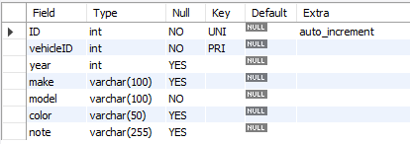
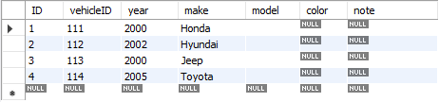
add column
CREATE TABLE vehicles (
vehicleID INT PRIMARY KEY ,
year INT,
make VARCHAR(100)
);
ALTER TABLE vehicles
ADD ID INT UNIQUE auto_increment first,
ADD model VARCHAR(100) not null,
ADD color VARCHAR(50),
ADD note VARCHAR(255);
INSERT INTO vehicles VALUES (111, 2000, 'Honda');
INSERT INTO vehicles VALUES (112, 2002, 'Hyundai');
INSERT INTO vehicles VALUES (113, 2000, 'Jeep');
INSERT INTO vehicles VALUES (114, 2005, 'Toyota');

Slide 153
modify column
ALTER TABLE tbl_name [alter_specification [, alter_specification] ...]
alter_specification
MODIFY [COLUMN] col_name column_definition [FIRST | AFTER col_name]

Slide 154
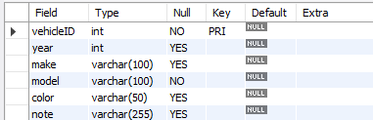
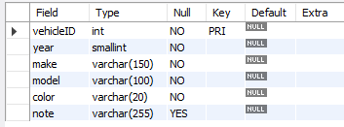
modify column
CREATE TABLE vehicles (
vehicleID INT PRIMARY KEY ,
year INT,
make VARCHAR(100),
model VARCHAR(100) not null,
color VARCHAR(50),
note VARCHAR(255)
);
ALTER TABLE vehicles
MODIFY year SMALLINT not null,
MODIFY make VARCHAR(150) not null,
MODIFY color VARCHAR(20) not null;
INSERT INTO vehicles VALUES (111, 2000, 'Honda', 'A1', 'silver', ' Honda was the first Japanese automobile manufacturer to release a dedicated luxury brand, Acura, in 1986.');
INSERT INTO vehicles VALUES (112, 2002, 'Hyundai', 'AC1', 'white', ' Hyundai operates the world's largest integrated automobile manufacturing facility in Ulsan, South Korea which has an annual production capacity of 1.6 million units.');
INSERT INTO vehicles VALUES (113, 2000, 'Jeep', 'D2', 'black', ' Fiat Chrysler Automobiles has owned Jeep since 2014. Previous owners include the Kaiser Jeep Corporation and American Motors Corporation. Most Jeeps are American-made, except for a select few models. The Toledo Assembly Complex in Ohio manufactures the Jeep Wrangler.');

Slide 155
change column
ALTER TABLE tbl_name [alter_specification [, alter_specification] ...]
alter_specification
CHANGE [COLUMN] old_col_name new_col_name column_definition [ FIRST | AFTER col_name ]

Slide 156
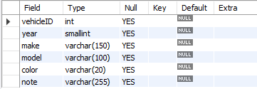
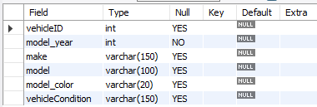
change column
CREATE TABLE vehicles (
vehicleID INT,
year SMALLINT,
make VARCHAR(150),
model VARCHAR(100),
color VARCHAR(20),
note VARCHAR(255)
);
ALTER TABLE vehicles
CHANGE year model_year INT,
CHANGE color model_color VARCHAR(20),
CHANGE note vehicleCondition VARCHAR(150);

Slide 157
change column
CREATE TABLE users (
ID INT PRIMARY KEY,
userName VARCHAR(40),
password VARCHAR(25),
email VARCHAR(255)
) ;
CREATE TABLE login (
ID INT PRIMARY KEY,
userID INT,
loginDate DATE,
loginTime TIME,
constraint fk_userID FOREIGN KEY(userID) REFERENCES users(ID)
) ;
INSERT INTO users VALUES (1, 'rajan', 'ranaj123', 'rajan447.gmail.com');
INSERT INTO users VALUES (2, 'raj', 'raj', 'raj.gmail.com');
INSERT INTO login VALUES (1, 1, curdate(), curtime());
INSERT INTO login VALUES (2, 1, curdate(), curtime());
INSERT INTO login VALUES (3, 2, curdate(), curtime());
INSERT INTO login VALUES (4, NULL, curdate(), curtime());
ALTER TABLE users CHANGE ID userID INT;
ALTER TABLE login CHANGE userID UID INT;
INSERT INTO login VALUES (5, NULL, curdate(), curtime());

Slide 158
drop column
ALTER TABLE tbl_name [alter_specification [, alter_specification] ...]
alter_specification
DROP [COLUMN] col_name

Slide 159
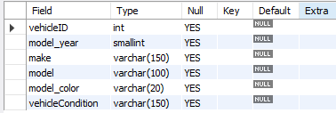

drop column
CREATE TABLE vehicles (
vehicleID INT,
model_year SMALLINT,
make VARCHAR(150),
model VARCHAR(100),
model_color VARCHAR(20),
vehicleCondition VARCHAR(150)
);
ALTER TABLE vehicles
CHANGE model_year year INT not null,
DROP model,
DROP model_color,
DROP vehicleCondition;

Slide 160
alter table
Sample table
Rename columns
CREATE TABLE vehicles (
vehicleID INT PRIMARY KEY ,
year INT,
make VARCHAR(100)
);
ALTER TABLE vehicles
CHANGE year model_year SMALLINT NOT NULL,
CHANGE color model_color VARCHAR(20),
CHANGE note vehicleCondition VARCHAR(150);
Add new columns to a table
DROP columns
ALTER TABLE vehicles
ADD model VARCHAR(100) NOT NULL,
ADD color VARCHAR(50),
ADD note VARCHAR(255);
ALTER TABLE vehicles
CHANGE model_year year INT NOT NULL,
DROP model,
DROP model_color,
DROP vehicleCondition;
Modify columns
ALTER TABLE vehicles
MODIFY year SMALLINT NOT NULL,
MODIFY color VARCHAR(20) NOT NULL,
MODIFY make VARCHAR(150) NOT NULL;

Slide 161
drop table
Remember:
DROP and TRUNCATE are DDL commands, whereas DELETE is a DML command.
DELETE operations can be rolled back (undone), while DROP and TRUNCATE operations cannot be rolled back (DDL statements are auto committed).
Dropping a TABLE also drops any TRIGGERS for the table.
Dropping a TABLE also drops any INDEX for the table.
Dropping a TABLE will not drops any VIEW for the table.
If you try to drop a PARENT/MASTER TABLE, it will not get dropped.

Slide 162
drop table
DROP [TEMPORARY] TABLE [IF EXISTS] tbl_name [, tbl_name] ...
Note:
All table data and the table definition are removed.
DROP login;
DROP TABLE users;
DROP TABLE login, users;

Slide 163

"Live as if you were to die tomorrow.
Learn as if you were to live forever"

